Slide 1

Agentic AI and the future of optimization development
JetBlue - Francisco Zenteno

Slide 2


About me
Senior Operations Research Scientist at American Airlines - 10 years in applied Operations Research.
Education
Bachelors in Industrial Engineering PUC
Masters in Operations Research PUC Masters in Computer Science UCSD

Slide 3
SEFOP -
Software Engineering Framework for Optimization Programs
Free & public repository:
Shows how to design your optimization program with software principles
Provides you teaching material for you to learn as well
Created from industry experience & presented at different conferences
Link: https://github.com/sefop
Python training: https://github.com/sefop/training-testing-python
Guides: https://github.com/sefop/sefop-training-hub/tree/main/guides
Today’s presentation: https://github.com/sefop/sefop-training-hub/tree/main/workshops/2026-07-06-jetblue
Leave a star if you like it ☺

Slide 4
Agenda
Why learn software engineering?
How to use agents in my optimization project
Demo

Slide 5
BLOCK 1
Why learn Software Engineering?

Slide 6

Software engineering principles always apply… whether you know them or not
Tragedy in the academy¹:
Geoffrey Chang, Scripps Institute (2006) A sign error in a data-processing script corrupted all results. 5 high-impact papers on membrane protein structures retracted.
Tragedy in the industry²:
Ariane 5 Rocket Explosion (1996) A reused software component caused an unhandled
overflow exception.
The rocket self-destructed 37 seconds after launch. $370 million USD payload destroyed.
Ariane flight V88 exploding during launch
Source: https://en.wikipedia.org/wiki/Geoffrey_Chang
Source: https://en.wikipedia.org/wiki/Ariane_flight_V88

Slide 7
Symptoms of being in a bad spot
Can't reproduce your own results quickly.
Code runs on your machine, but not in your teammate’s.
You are afraid of making changes.
Adding new things to the codebase is difficult.
There are not enough tests to check the codebase works as expected.
Low morale of the team working on the codebase. Unknown crashes of the codebase.
Other examples? – mention Russel Beckett example

Slide 8



Wait… why not delegate this to an agent?
What are your thoughts?
Recent industry research shows that¹:
AI’s primary role in software development is that of an amplifier, magnifying an organization’s existing strengths and weaknesses. The greatest returns on AI investment come not from the tools themselves, but from a strategic focus on the underlying organizational system.
At the end of the day, you are responsible for the product, not who wrote it (ai-agent, student, teammate, etc).
Source: Google DORA Report 2015: https://dora.dev/research/2025/dora-report/

Slide 9
BLOCK 2
How to use agents in my optimization project
Note: the following instructions are tailored for Claude, but they work similar for other agents.

Slide 10
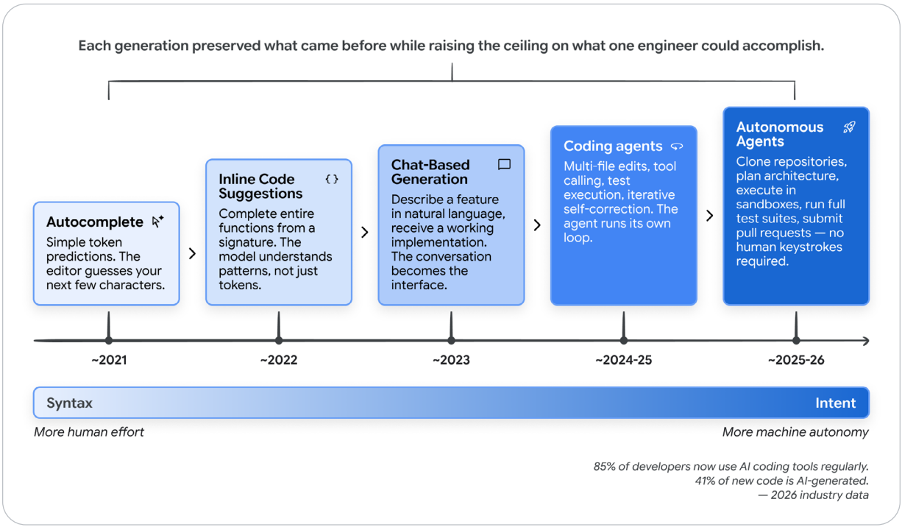
Disclaimer: things are moving fast
Source: The New SDLC With Vibe Coding: From ad-hoc prompting to Agentic Engineering (Google, 2026)
Notes:
The recommendations of this workshop might get obsolete soon.

Slide 11

Overview of the example project
Service description
How many items to pick to maximize the calories without exceeding the capacity and budget?
You have a specialized software to solve knapsack problems.
Given a request like the one on the right, the service should output a solution to your client.
Weight: 1 kg
Calories: 500 Price: 1 usd
Weight: 0.4 kg
Calories: 100 Price: 0.5 usd
Capacity: 1 kg
Budget: 10 usd
Weight: 0.3 kg
Calories: 600 Price: 2 usd
Weight: 2 kg
Calories: 1000 Price: 3 usd
Source: https://github.com/sefop/sefop-python-starter

Slide 12






Phases in traditional SDLC*
1. Spec definition
2. Coding
3. Team review
Idea
Integration to main branch
Translate the idea into a structured feature specification — defining scope, requirements, and acceptance criteria.
Output: a written document (ex: GitHub Issue)
Implement the feature according to the specification in a new branch, producing working, tested code ready for review.
Output: a pull request (PR)
The team reviews the implementation against the spec and may provide feedback (go to step 2 if needed). All the blocking workflows (ex: unit tests) should be passing.
Output: permission or not for the author to merge PR to main branch
* Deployment phase is out of the scope on this presentation

Slide 13
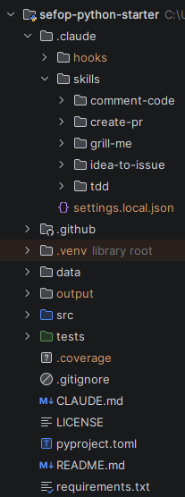
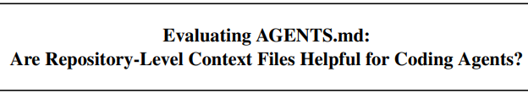
Setting up Claude
Deterministic instructions to be used on specific events. Out of the scope of this presentation.
Skills are invoked to improve its performance in specialized tasks (ex: design an interface for a module). It can spawn sub-agents.
Great source: https://github.com/mattpocock/skills
Essential context that we want the agent to always have. According to this paper, LLM-generated repository context files reduce task success rates, while also increasing inference costs in 20%. Prefer human-written and verified content and add elements as needed.
Prefer scientific evidence over anecdotes. There are a lot of ‘gurus’ out there.
1) Instructions over ~1k lines can lead to inconsistent behavior -> Unlocking the full power of Copilot code review: Master your instructions files - The GitHub Blog
Notes:
If the instruction file is too big, it is not guaranteed to be followed completely, or if another context present is contradicting, or confusing.
Add elements to the instructions as needed: for instance we had indicated wrongly that the project used Java 11, when actually it used Java 8. It was wrongly adding J11 snippets of code that did not compile. Then we corrected this definition and it the agent started to avoid that mistake.

Slide 14
Other settings…
Provide authentication to your GitHub account so the agent can read your repository on the web.
Make sure your CLI can run build/test commands on your terminal (on this repo: `pytest`)
Connect to GitHub CLI so the agent can create PRs automatically.
Allow Claude access to tackle GitHub issues by invoking @claude.

Slide 15

Bottleneck
Comparing approaches
Parallelizable
Estimated times are human-time spent.
Spec definition
Coding
Team review
< 3 min
1–3 days
30–120 min
Personal notes
Mental model
No structured output usually
Does most of the coding
Team review tests and code manually.
Self-coding
approach
Usually does not help
Agent may help vibe-coding
Optional: use agent reviewer
Agent-delegation approach

Slide 16
Bottleneck
Comparing approaches
Parallelizable
Estimated times are human-time spent.
Spec definition
Coding
Team review
< 3 min
1–3 days
30–120 min
Personal notes
Mental model
No structured output usually
Does most of the coding
Team review tests and code manually.
Self-coding
approach
Usually does not help
Agent may help vibe-coding
Optional: use agent reviewer
5–20 min
0.5–2 hr
15–60 min
Starts an interview process (local machine + plan mode) and answers it.
Reviews the spec¹ until approved.
Assigns the agent in the GitHub issue.
Then reviews/edits the branch before submitting the PR for review.
Team review tests and code manually (more skim now).
Agent-delegation approach
Starts the interview with the /idea-to-issue² skill (plan mode)
Creates the issue automatically (Github CLI)
Implements the spec in the cloud and creates a draft PR.
Make edits as suggested by the human (cloud or local).
Default: use agent reviewer
1) It’s the responsibility of the human to decide the scope and success criteria.
2) Inspired by the “/grill-me” skill, Source: skills/grill-me/SKILL.md at main · mattpocock/skills
Notes:
Note: the coding phase in the agent-delegation approach is parallelizable.
Note: the bottleneck on each approach is different: in the first is coding, in the second is team review.

Slide 17


BLOCK 3
DEMO
Select a high-reasoning model
/idea-to-issue add a new constraint to the model. From user feedback I need to prohibit products with low calories. In particular, I need to prohibit any product with 20 calories or less. Let's create a plan. Use /tdd and /comment-code to design this task

Slide 18

Why this process works
Modular code
Spec quality
Test automation
Agents can work in isolation on different issues in parallel.
PRs are smaller and easier to review.
Software design is thought to provide modularization
Well-designed issues = clear acceptance criteria for review
The agent invests significant time (roughly equal as developing) to understand what must be done with the human guideline.
Tests guide the agent to know the spec is correctly implemented.
Other tests (unit + integration) guide the agent/reviewer to know it has not broken other parts of the code.
Unit tests provide high code coverage (96%), even at the model formulation level.
Integration tests (7 currently) provide a different safety net: making sure real scenarios comply with business requirements.
→ The automatic tests provide deterministic, repeatable, evidence that the program works as expected.
Coding guidelines
Language-specific instructions help (but does not guarantee) the agent to comply with Static Code Analysis Tools (ex: SonarQube) and the language best practices.
Language-agnostic instructions help (but does not guarantee) the agent with software design and other engineering principles (ex: TDD).

Slide 19
Final thoughts
This is changing fast, learn, experiment and adapt quickly.
Trust in the agent is not earned, it is proven through evidence (automatic tests?).
Ownership: you are the end owner, not the agent.
The bottleneck in the SDLC has changed from coding to validation, thus invest in making this bottleneck as efficient as possible:
Example: decrease the time to review PRs, such as only requiring 1 reviewer.
Example: create easy to review PRs.
Calibrate over time how many issues you can handle in parallel. Context switching is exhausting.
Invest in software engineering principles to make sure you are not just creating technical debt faster.
When the agent makes a mistake constantly, think how to fix agent instructions so it does not repeat the error again.
Open questions:
Should the reviewing agent use a different model than the coding agent? How to achieve an unbiased analysis?
How to be economically $$$ efficient with token usage?

Slide 20

Thank you
Provide your feedback here please:
https://forms.gle/Ajp2wa3kgcDhyGDW7

